Slide 1
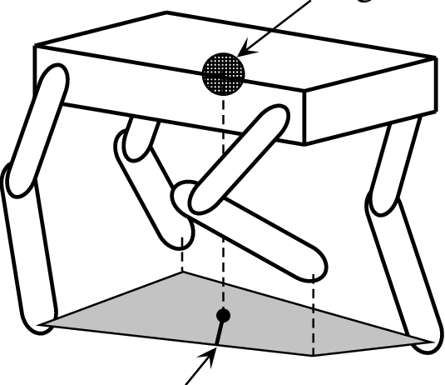
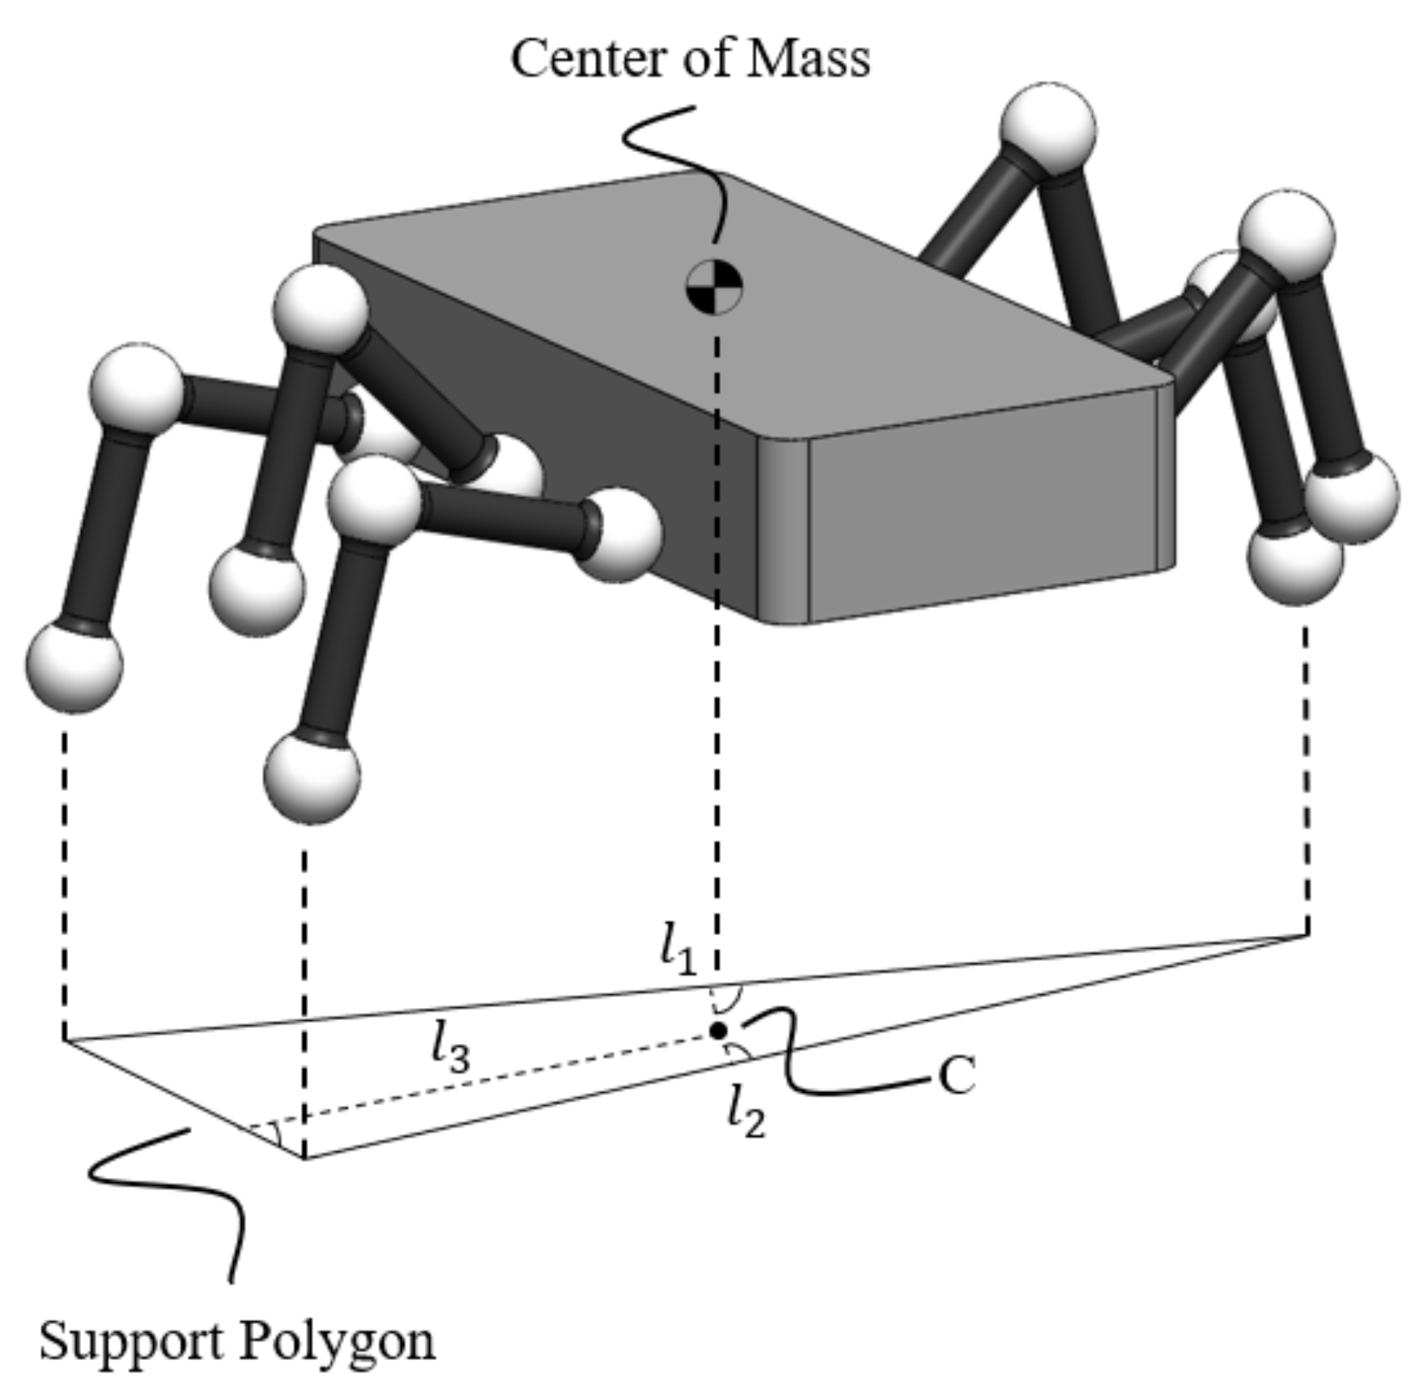
Stability Criterion for Dynamic Gaits of Quadruped Robot
Presented by :-
Yash Chavan
2020A4PS1972G

Slide 2
Objective/Purpose of the Paper:-
This paper presents a new stability criterion for the motion of quadruped robots with dynamic gaits running over irregular terrain
The traditional zero-moment point (ZMP) is improved to analyze the motion on irregular terrain precisely for dynamic gaits
**ZMP refers to a point on the ground where the net torque in the direction parallel to the ground caused by the gravity and inertial forces of each part of the robot is zero

Slide 3
Researchers have proposed a variety of static- and dynamic-stability-analysis methods to evaluate the stability of legged robot
The static-stability criteria and margins are only applicable for analyzing low-speed static gaits rather than the dynamic motion because they do not consider inertial forces or external impacts
Fukuoka and Kimura
Robot can maintain its balance if the projection of the center of mass (CoM) of the body is within the support polygon formed by the projection of the current support and swing feet on the horizontal plane; the shortest distance from this projection point to the boundaries of the support polygon is used to evaluate the robot’s stability.
Researchers believe that the robot is stable if ZMP is located inside the support polygon, which is connected to the support feet. The minimum distance between ZMP and the support boundaries is used as the stability margin. The larger the minimum distance is, the better the stability that the robot can achieve
In practice, even if ZMP is not located on the current support line, the robot will not necessarily lose its balance and fall. Hence, it is difficult to correctly evaluate the stability of the robot by directly using the distance between ZMP and the current support line.

Slide 4
The good stability criterion and evaluation method should have the following characteristics:
(1) It should determine the stability state of the robot efficiently and correctly
(2) It should evaluate the robot’s stability accurately
(3) It should provide guidance for the robot’s motion planning and balance recovery
Inspiration
When animals experience impacts in nature, they quickly adjust the position of their next set of support feet to maintain stability. This indicates that dynamic stability depends not only on their current motion and support state but also on the positions of the next set of support points.
Implementation (New Method)
Based on the above ideas, by defining and adjusting the virtual-support plane, the traditional ZMP can be extended to three-dimensional (3D) space so that it can be used to analyze the motion state on irregular terrain. An extra term containing the velocity of the robot’s body is added to the equation for the calculation of ZMP to better reflect the robot’s motion state.

Slide 5
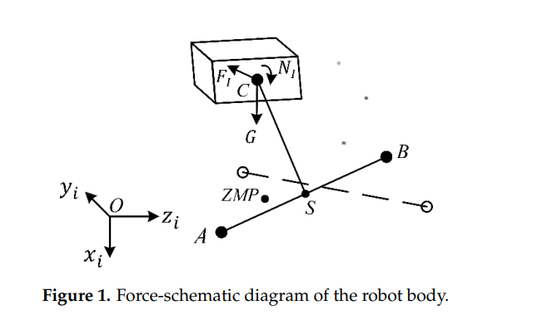
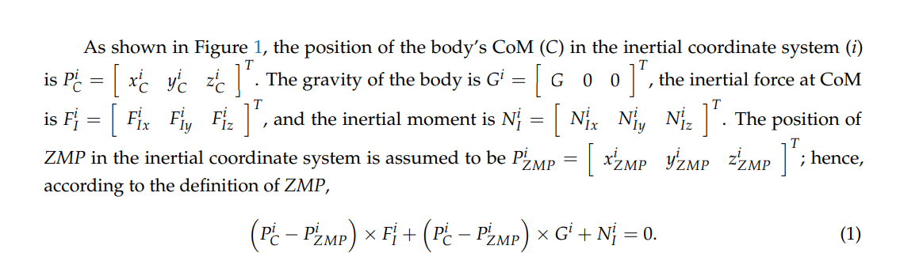
ZMP for Irregular Terrain
Assumption
Most of the mass is concentrated in the body of the robot, the mass of the legs is ignored to simplify our stability analysis

Slide 6

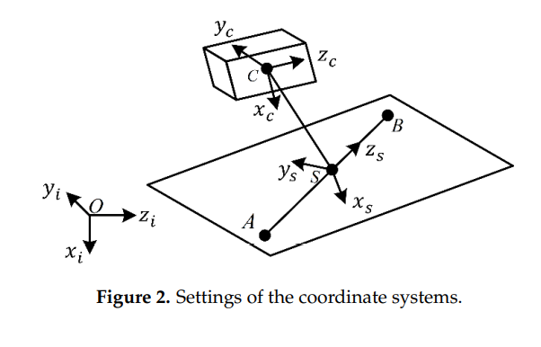
Only two of the three equations are linearly independent
ZMP is always located on the current support plane (which can be nonhorizontal)
The origin of this coordinate system is located at the midpoint S of the current support line AB, the direction of zs is from the rear foot to the front foot of the current support line, and xs is perpendicular to the current support plane and points downward. Another coordinate system used in this paper is the principal axes coordinate system of the body (c), whose origin is located at the body’s CoM.

Slide 7
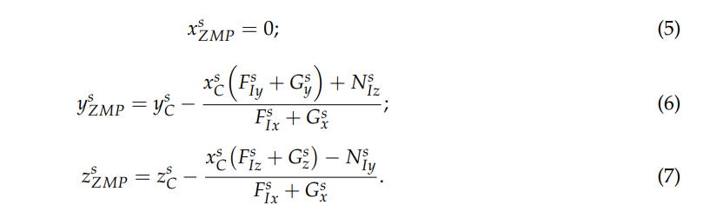
It is difficult to ascertain the actual support plane for some dynamic gaits (trotting, pacing, bounding, etc.) because only two support feet are used most of the time.

Slide 8
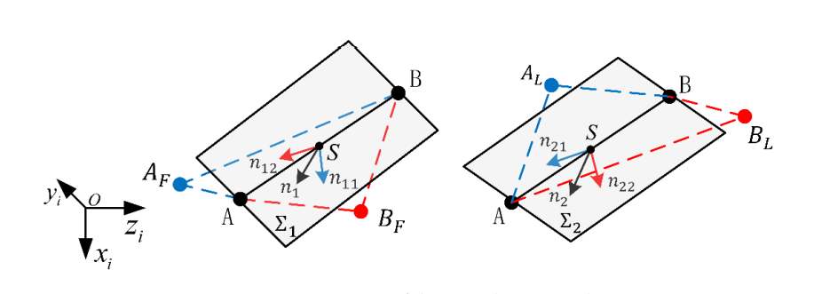
To solve this problem, the positions of the previous support line, AFBF, and the next support line, ALBL, are comprehensively considered
The following assumptions are made for the current virtual-support plane:
(1) This plane always contains the current support line AB
(2) From the disappearance of the previous support line to the disappearance of the current support line, the virtual-support plane gradually changes from Σ1 (determined by the current and previous support lines) to Σ2 (determined by the current and next support lines). In practice, for uneven terrain, AB and AFBF (or ALBL) may not lie on the same plane. This paper presents a method to determine the virtual-support plane

Slide 9
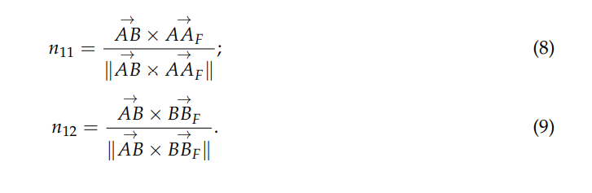
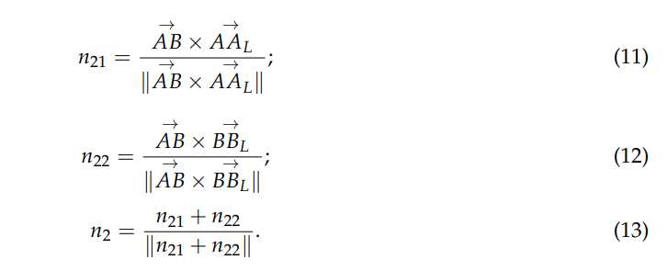

A, B, and AF lie is n11
A, B, and BF lie is n12
The unit normal vector n1 of the plane Σ1 lies on the bisector of the angle formed by n11 and n12

Slide 10
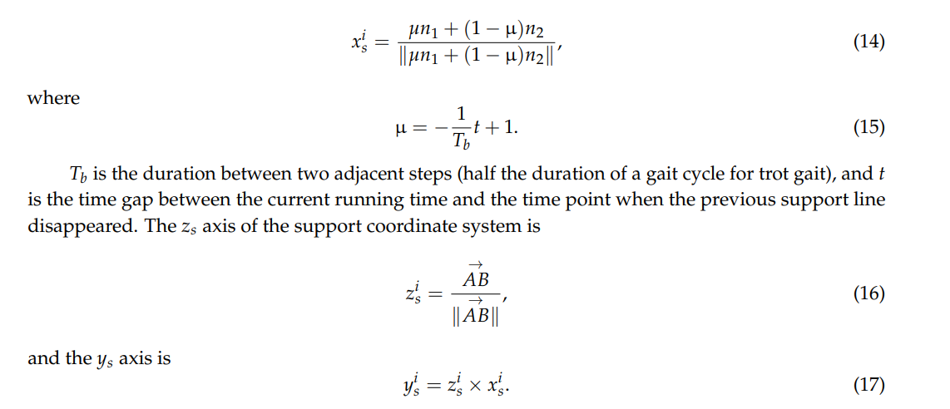

Slide 11
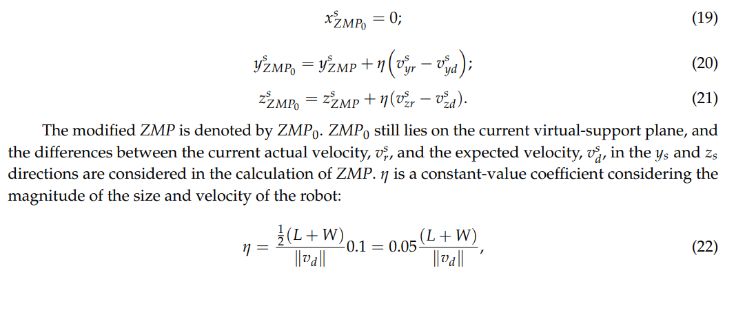
velocity is very important for maintaining balance, especially under some special condition
however, if the robot’s velocity is high enough to allow it to quickly enter a stable area, the robot can maintain its balance.
L is the length of the robot’s body and W is the width.
The expected benefits of doing so are the following:
The current stability of the robot can be assessed more accurately and efficiently
(2) A reference can be provided to eliminate undesired velocity during motion planning.

Slide 12
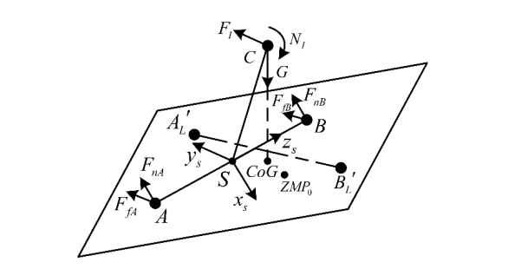
Dynamic-Stability Criterion
The stability of a robot with a dynamic gait is closely related to two factors:
(1)the ground-reaction forces that act on the current support feet
(2) the ground-reaction forces that will acting on the next support feet.
Fn, is perpendicular to the support plane and points outward, and its main role is to support the robot standing and to maintain the stability of the robot’s rotation around the ys and zs axes
The frictional force Ff is located on the support plane, which is opposite to the direction of the feet’s motion
The torque that prevents the robot from tipping around the zs axis can only be provided by the next set of support feet. The contact forces at AL’ and BL’ also play a supplementary role in maintaining rotational stability around ys . The rotation of the robot around xs is stopped by the friction
ZMP0 can be considered to be on the extension line of the equivalent force, Fe , acting at the CoM of the body

Slide 13
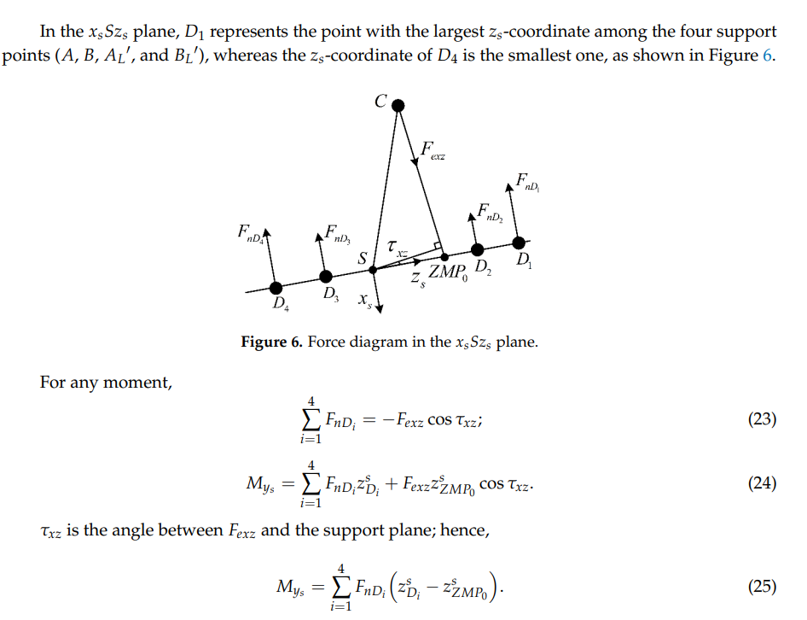

Slide 14
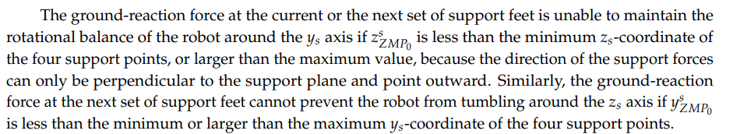
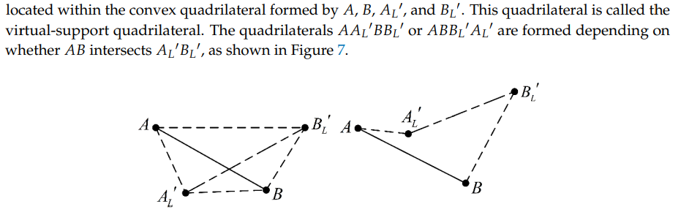

Slide 15
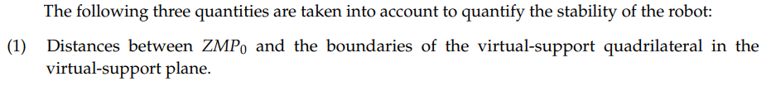
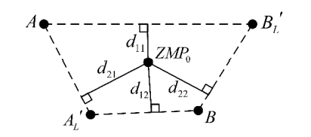
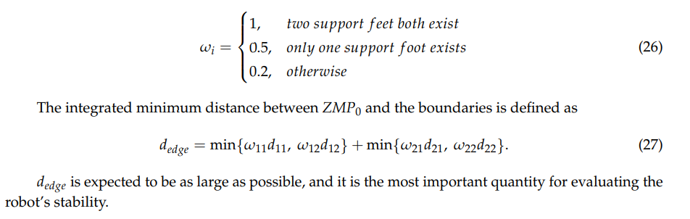
4. Dynamic-Stability Measurement
The instability of the robot is mainly caused by unbalanced rotation in two mutually perpendicular directions. Therefore, the distances between ZMP0 and the two sets of opposite boundaries (d11 and d12, and d21 and d22) should be considered when evaluating the stability of the robot
The two support points forming a certain boundary of the quadrilateral do not necessarily exist at present. Hence, the distances between ZMP0 and boundaries should be multiplied by their corresponding coefficients 𝜔𝑖 , which are defined as follows:

Slide 16
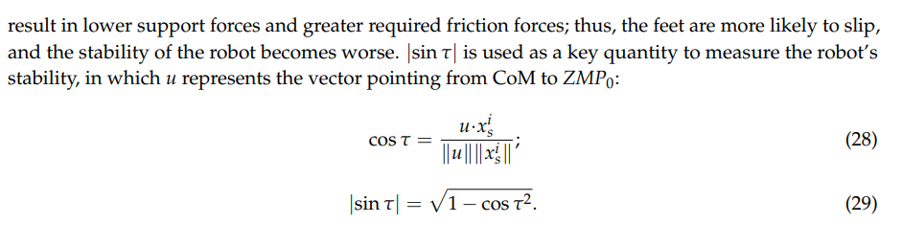
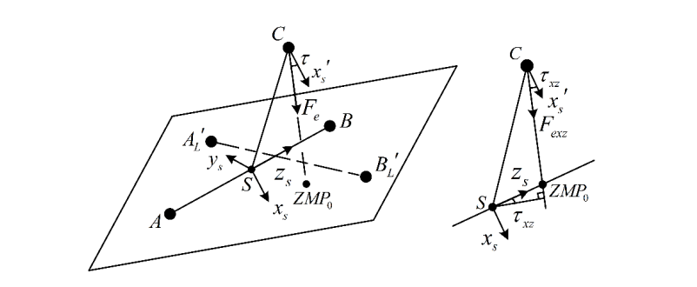

Slide 17
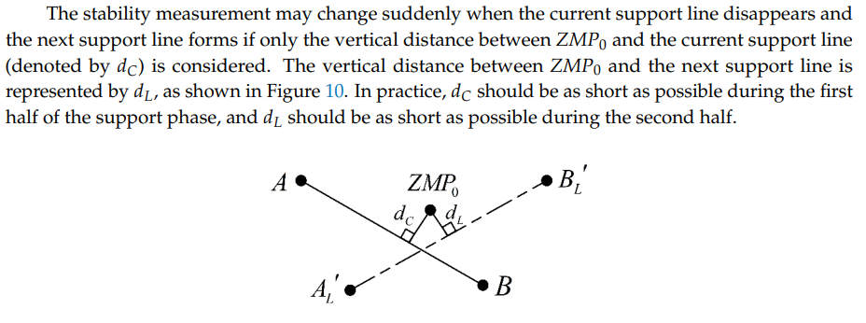
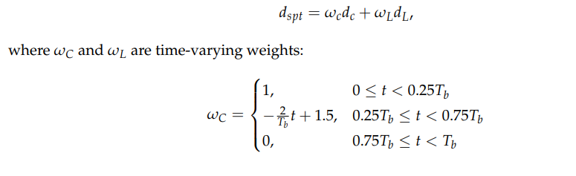
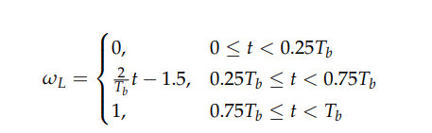

Slide 18

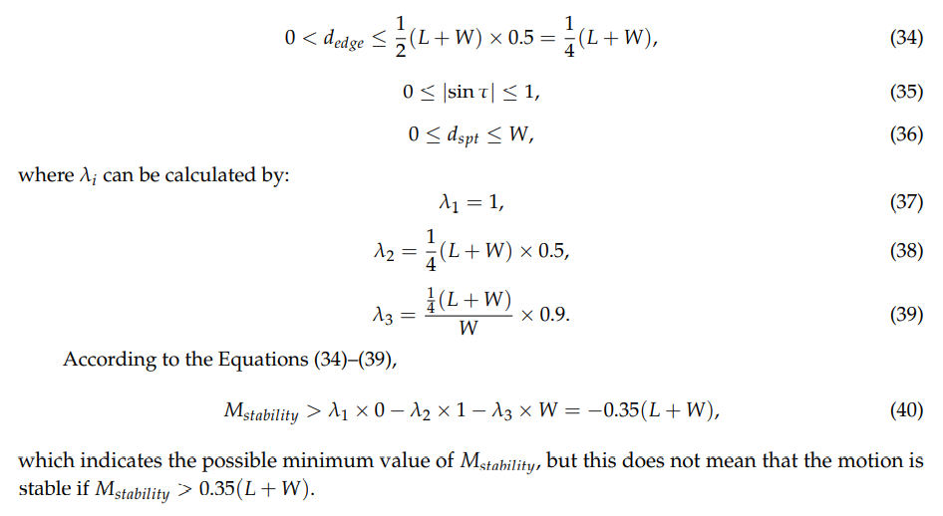

Slide 19
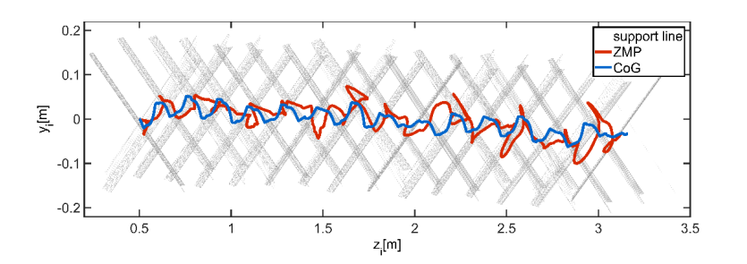
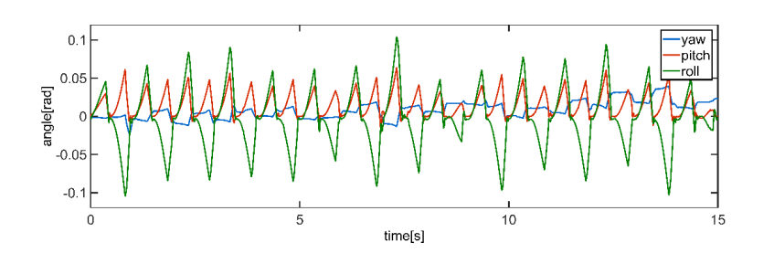

Slide 20

